Slide 1
Stata (Level 1 – Data) Workshop
Text
Text
Quantitative and Computing Lab (QCL)
Text
Text

Slide 2
Before We Begin
Sign-in Link
Retrieve Workshop file at (https://github.com/CMC-QCL/STATA-L1-Workshop/blob/students/Stata_Workshop_Files.zip)
After you have downloaded “Workshop_Files” compressed file, extract the folder on “Desktop”
Learning Objective: Ensure that all participants gain some level of confidence using Stata and statistical analysis
Tip: Open .do, PDF, and any other files that I am using throughout the workshop to make sure that you are following along.

Slide 3
Workshop Agenda
1
User Interface: Console
03:00 PM – 03:05 PM
User Interface: Console
2
Data Import
Data Import
03:05 PM – 03:10 PM
3
Define Data
Define Data
03:10 PM – 03:25 PM
4
Summary Statistics
Summary Statistics
03:25 PM – 03:50 PM
5
Regression Analysis
03:50 PM – 04:15 PM
6
Charts: Histogram and Scatter Plot
04:15 PM – 04:20 PM
7
Hands-on Exercises
04:20 PM – 04:50 PM
8
Q&A
04:50 PM – 05:00 PM

Slide 4
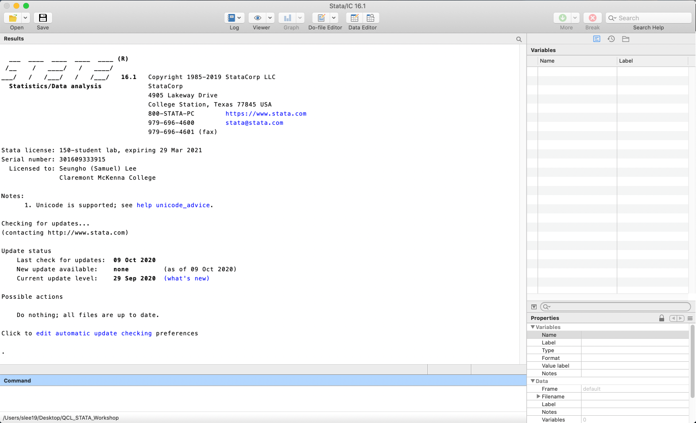
Stata Console – Main Window
1
8
9
10
11
12
13
14
15
16
17
18
19
20
21
22
23
24
25
26
2
3
4
5
6
7
Stata window largely consists of command history, command line, output window, variable list, and data format.
1
Results: displays commands and resulting outputs from current session
1
3
4
2
Command Line: a window where a user enters a command
3
Variable List: lists all variables specified in active session
4
Command History: shows every command performed in active session
5
5
Data Format: detailed description of highlighted variable (e.g., type)
2

Slide 5
Stata Console – How It Works
1
8
9
10
11
12
13
14
15
16
17
18
19
20
21
22
23
24
25
26
2
3
4
5
6
7
While Stata is truly “interactive,” users can also run a program as a “batch” mode (running commands listed on a file)
Interactive Use: typing Stata commands directly on the Command window to produce results.
Batch Mode: All commands are compiled in a file (called Do-Files), which Stata reads and executes.
During this workshop, we are going to use Do-File “.do” to import and explore data and conduct relevant analysis

Slide 6
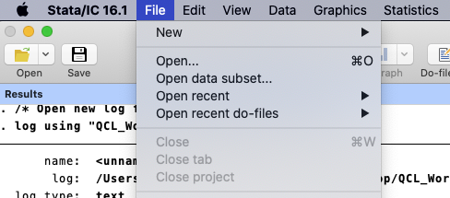
Stata Console – Do-Files (Open)
1
8
9
10
11
12
13
14
15
16
17
18
19
20
21
22
23
24
25
26
2
3
4
5
6
7
Press “File” on a top menu bar
Select “Open…”
Go to “Workshop_Files” folder we downloaded on “Desktop” folder
Open “Stata_Workshop_QCL.do” file

Slide 7
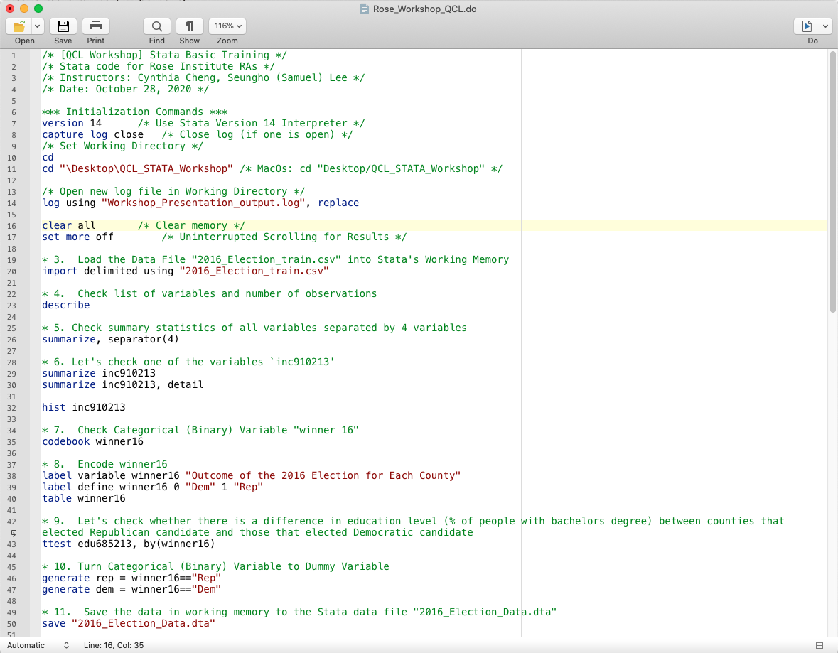
Stata Console – Do-Files
1
8
9
10
11
12
13
14
15
16
17
18
19
20
21
22
23
24
25
26
2
3
4
5
6
7
Think of it as a set of instructions for Stata to conduct without manual input
It is a good practice to compile Do-File since doing so allows others to reproduce
Comment:
/* [INSERT COMMENT] */: comments a specified section
*: comments a whole line
Press boxed icon shown on the screenshot to execute the file

Slide 8
Data Import
1
8
9
10
11
12
13
14
15
16
17
18
19
20
21
22
23
24
25
26
2
3
4
5
6
7
Setting Working Directory:
“cd” command sets which folder you are going to be working on
Make sure to include data files in the folder
Importing Data
Run import delimited using “filename.csv” command to import data files
You can also import Excel files (and many others) as well as direct URL link!
Notes:
Reg, scatter, corr., skewness (10-15 min last → go through hands-on q’s)

Slide 9
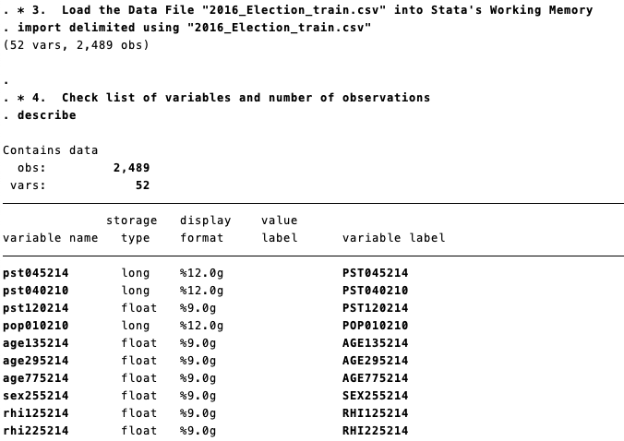
Define data
1
8
9
10
11
12
13
14
15
16
17
18
19
20
21
22
23
24
25
26
2
3
4
5
6
7
Whenever you use import function, it outputs a message that indicates the numbers of variables and observations in the dataset. For more details, use describe
Data: Sampled 2016 Presidential Election Data by Counties (ECON122)
describe function can be used see a more detailed information of the imported data:
Observations, Variables
Variable Name, Storage Type (e.g., long, float), Display format, value label, variable label
On Stata, you can label values and variables, which are helpful references (we will look at these functions during the Hands-on Exercise)

Slide 10
Define data
1
8
9
10
11
12
13
14
15
16
17
18
19
20
21
22
23
24
25
26
2
3
4
5
6
7
Whenever you use import function, it outputs a message that indicates the numbers of variables and observations in the dataset. For more details, use describe
Common Storage Types
byte: integer values between -127 and 100
int: integer values between -32,767 and 32,740
long: integer values between -2,147,483,647 and 2,147,483,620
float: real numbers (i.e., numbers with decimal points) with about 8 digits of accuracy
double: real numbers (i.e., numbers with decimal points) with about 16 digits of accuracy
str3: string values with a maximum length of 3
What does having string values imply about the variable? (winner16 is a string variable!)
Notes:
Winner16 variable has a storage type of “str3” → indicates that the variable contains string value, which is likely to be a categorical variable (e.g., types of car, “Yes” or “No” binary values)

Slide 11
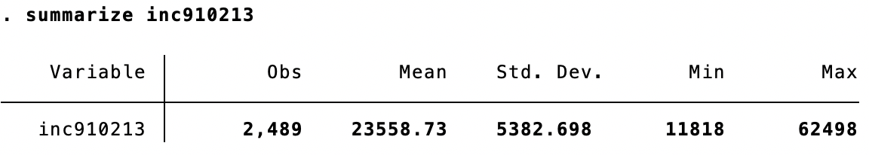
Summary Statistics
1
8
9
10
11
12
13
14
15
16
17
18
19
20
21
22
23
24
25
26
2
3
4
5
6
7
summarize function can be used see a more detailed information of the imported data:
Observations: number of observations in the variable
Mean: Mean (Average) Value of the variable
Standard Deviation
Min
Max

Slide 12
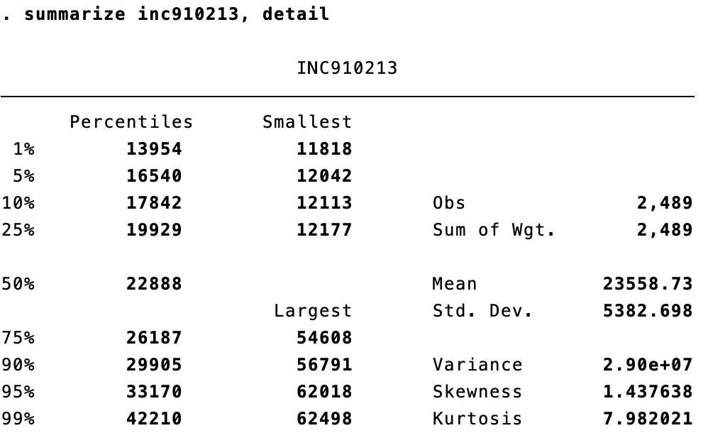
Summary Statistics
1
8
9
10
11
12
13
14
15
16
17
18
19
20
21
22
23
24
25
26
2
3
4
5
6
7
Including detail option in summarize allows users to check more specific statistics:
Percentiles: a value of the variable at a given percentile (50th Percentile = Median)
Smallest/Largest: 4 lowest/highest values
Skewness: degree of distortion in our distribution (from normal) and direction
Positive: skewed to the right
Negative: skewed to the left
Zero: Normal
Kurtosis: how “fat” the tails are in the distribution, which shows whether there are extreme outliers in the data
High deviation from 3 indicates that there is high kurtosis
Mean cannot be captured correctly,
leading to wrong interpretation!

Slide 13
Summary Statistics
1
8
9
10
11
12
13
14
15
16
17
18
19
20
21
22
23
24
25
26
2
3
4
5
6
7
Mean cannot be captured correctly,
leading to wrong interpretation!

Slide 14
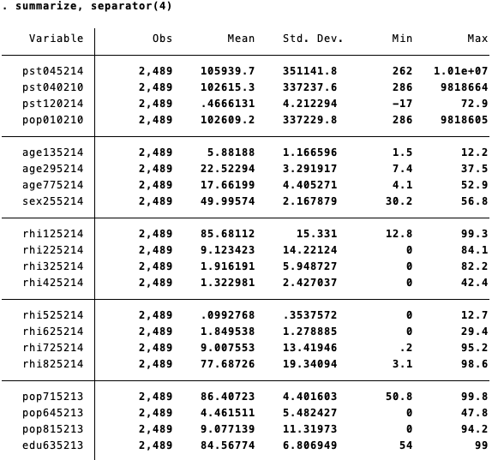
Summary Statistics
1
8
9
10
11
12
13
14
15
16
17
18
19
20
21
22
23
24
25
26
2
3
4
5
6
7
Summarize function can be used to see more detailed information about each variable. This can be done with all at once or on an individual basis
For a summary statistics output for all variables, following values are produced for each variable:
Observations
Mean
Standard Deviation
Min
Max
What can we know about winner16 variable?

Slide 15
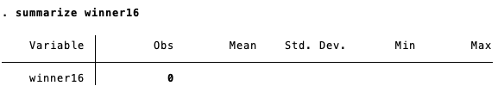
Summary Statistics
1
8
9
10
11
12
13
14
15
16
17
18
19
20
21
22
23
24
25
26
2
3
4
5
6
7
Summarize function can be used to see more detailed information about each variable. This can be done with all at once or on an individual basis
Why does winner16 have 0 observation?
As we mentioned before, it is stored as a string type, which needs to be recoded
Let’s try codebook function to check what string inputs are recorded in the variable

Slide 16
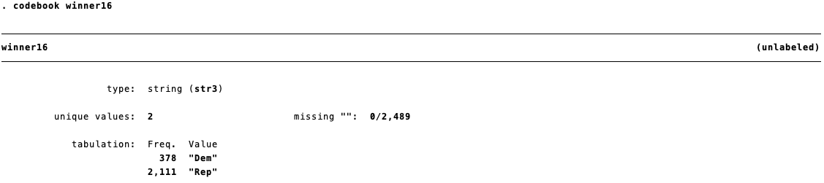
Summary Statistics
1
8
9
10
11
12
13
14
15
16
17
18
19
20
21
22
23
24
25
26
2
3
4
5
6
7
We can see that there are 378 occurrences of “Dem” and 2,111 occurrences of “Rep”
As we can see from a boxed corner, our binary variable is not labeled
By labeling / encoding our data, we are able to assess statistical significance of differences between different groups (or string values), which is done with t-test
Let’s label winner16 variable and run t-test

Slide 17
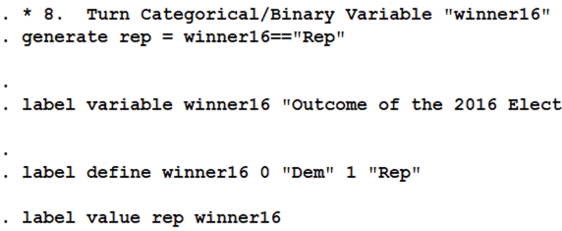
Categorical Data – Processing
1
8
9
10
11
12
13
14
15
16
17
18
19
20
21
22
23
24
25
26
2
3
4
5
6
7
Labeling is useful in analyzing variables from different observations based on their string values
Categorical Variables
Binary, Nominal, Ordinal
Can be used for classifying different categories, predicting categorical events, or explaining differences among categorical values
Numerical Variables
Continuous (infinite interval) or Discrete (finite)
Take on any value within a finite or infinite interval
Can be used for finding relationships and identifying characteristics
1
Creates rep variable with 1 = “Rep” (all else are 0)
2
Set winner16‘s label with a description
3
Define numerical values to winner16’s string values
4
Assign winner16 string values as rep labels

Slide 18
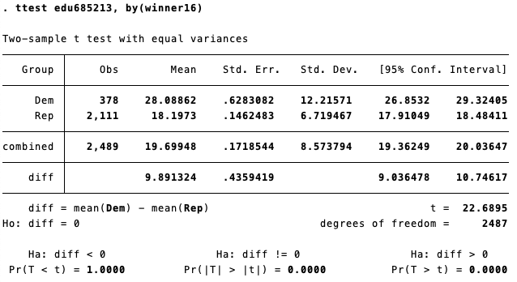
Summary Statistics (cont.)
1
8
9
10
11
12
13
14
15
16
17
18
19
20
21
22
23
24
25
26
2
3
4
5
6
7
This is t-test of % of county residents with bachelor’s degree (edu685213) on two string groups
Shows t-test result on difference between the two groups with summary statistics of each group and a complete dataset
Running t-test without specifying by condition produces the test on whether the variable is statistically significantly different from 0
Results
We find the difference statistically significant almost at 100% confidence level
We also find that the counties that elected a democratic candidate have higher proportion of college educated residents

Slide 19
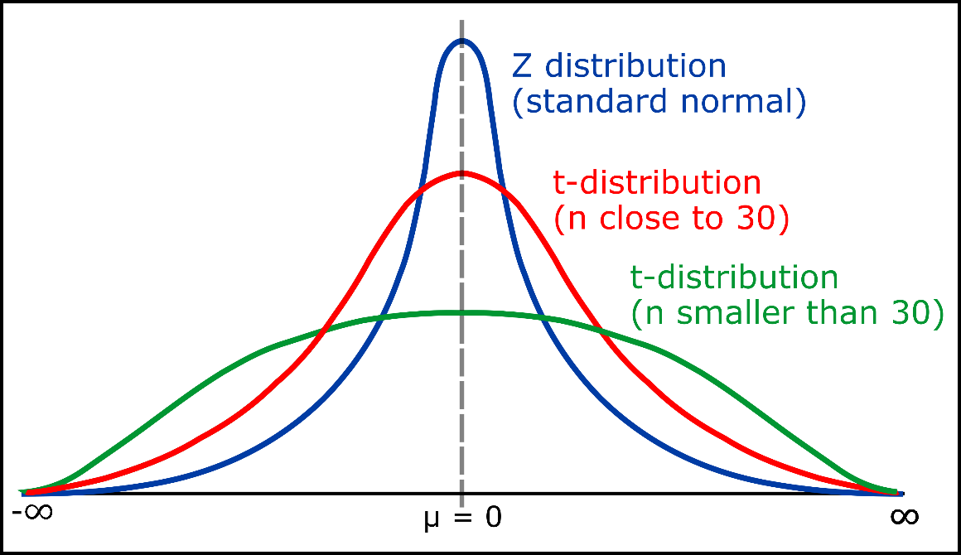
Summary Statistics
1
8
9
10
11
12
13
14
15
16
17
18
19
20
21
22
23
24
25
26
2
3
4
5
6
7
Size of the Sample
Large
Small
Use Normal Distribution
Population Distribution
Unknown but close to Normal Dist.
Known
Use t-Distribution
and also
Close to Normal Dist.
Different from Normal Dist.
Source: “Student’s t-distribution in Statistics,” GeeksforGeeks.org.
Use Normal Distribution
Use Non-Parametric Model

Slide 20
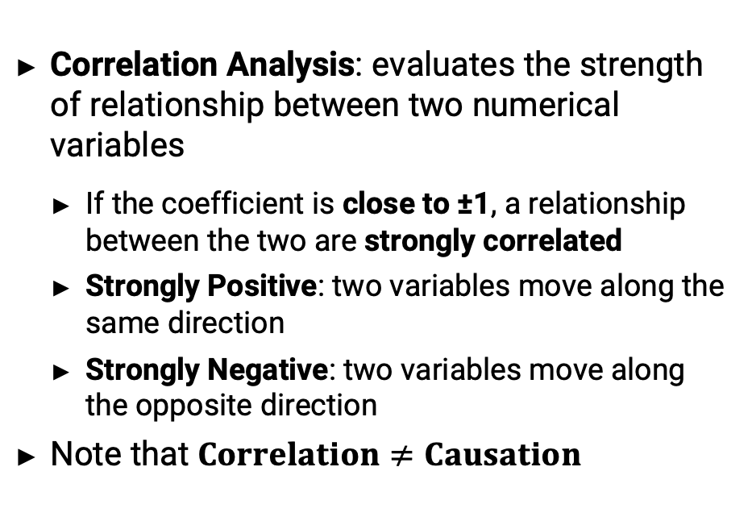
Regression – Background
1
8
9
10
11
12
13
14
15
16
17
18
19
20
21
22
23
24
25
26
2
3
4
5
6
7
Before jumping into analyzing winner16, let’s take a look at how population size impacts the number of firms in counties
Correlation Analysis: evaluates the strength of relationship between two numerical variables
If the coefficient is close to ±1, a relationship between the two are strongly correlated
Strongly Positive: two variables move along the same direction
Strongly Negative: two variables move along the opposite direction
Note that $Correlation≠Causation$

Slide 21
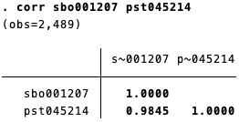
Regression – Background
1
8
9
10
11
12
13
14
15
16
17
18
19
20
21
22
23
24
25
26
2
3
4
5
6
7
Before jumping into analyzing winner16, let’s take a look at how population size impacts the number of firms in counties
Correlation Analysis: evaluates the strength of relationship between two numerical variables
If the coefficient is close to ±1, a relationship between the two are strongly correlated
Strongly Positive: two variables move along the same direction
Strongly Negative: two variables move along the opposite direction
If the two variables have corr. coefficient of 0.9845, what would the regression look like?

Slide 22
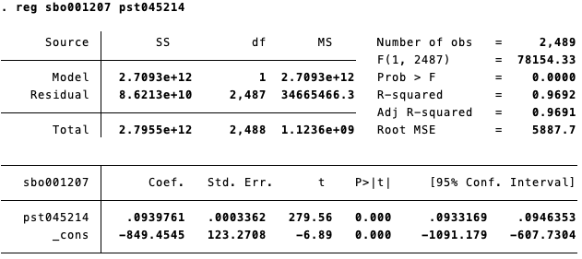
Regression – Background
1
8
9
10
11
12
13
14
15
16
17
18
19
20
21
22
23
24
25
26
2
3
4
5
6
7
Regression Output
Regression Plot
R² value is 0.9692, meaning that 96.92% of variation is explained
This is squared value of correlation coefficient that we saw earlier
Commands required to plot the regression:
predict yhat (right after running the regression)
twoway scatter yhat y x, connect(l .) symbol(i 0)
We will now regress Rep binary variable on % of college educated to see the relationship

Slide 23
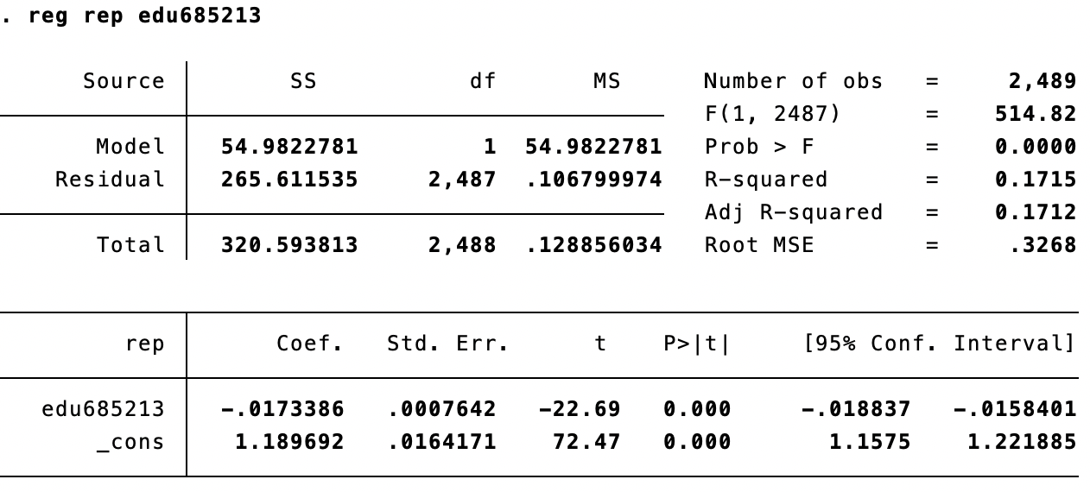
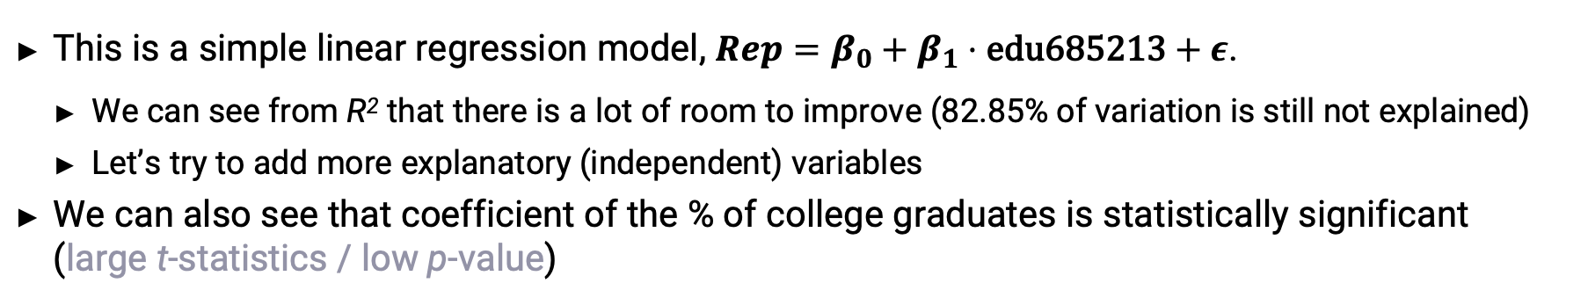
Regression – Simple Regression
1
8
9
10
11
12
13
14
15
16
17
18
19
20
21
22
23
24
25
26
2
3
4
5
6
7
This is a simple linear regression model, $Rep=β_{0}+β_{1}⋅\text{edu}\text{685213}+ε$.
We can see from R² that there is a lot of room to improve (82.85% of variation is still not explained)
Let’s try to add more explanatory (independent) variables
We can also see that coefficient of the % of college graduates is statistically significant (large t-statistics / low p-value)

Slide 24
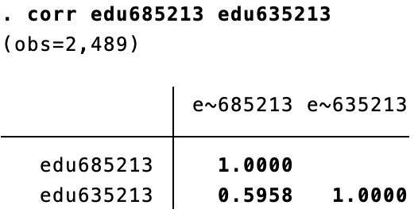
Regression – Multiple Regression
1
8
9
10
11
12
13
14
15
16
17
18
19
20
21
22
23
24
25
26
2
3
4
5
6
7
Take a look at a correlation between % of residents with bachelor’s degree and those with high school diploma (edu635213)
Rules of Thumb: No linear relationship = 0 Perfect linear relationship = ±1 Weak linear relationship = | 0 – 0.3 | Moderate linear relationship = |0.3 – 0.7| Strong linear relationship = |0.7 – 1.0|
Generally, adding two or more variables with R < 0.7 does not increase a presence of Multicollinearity

Slide 25
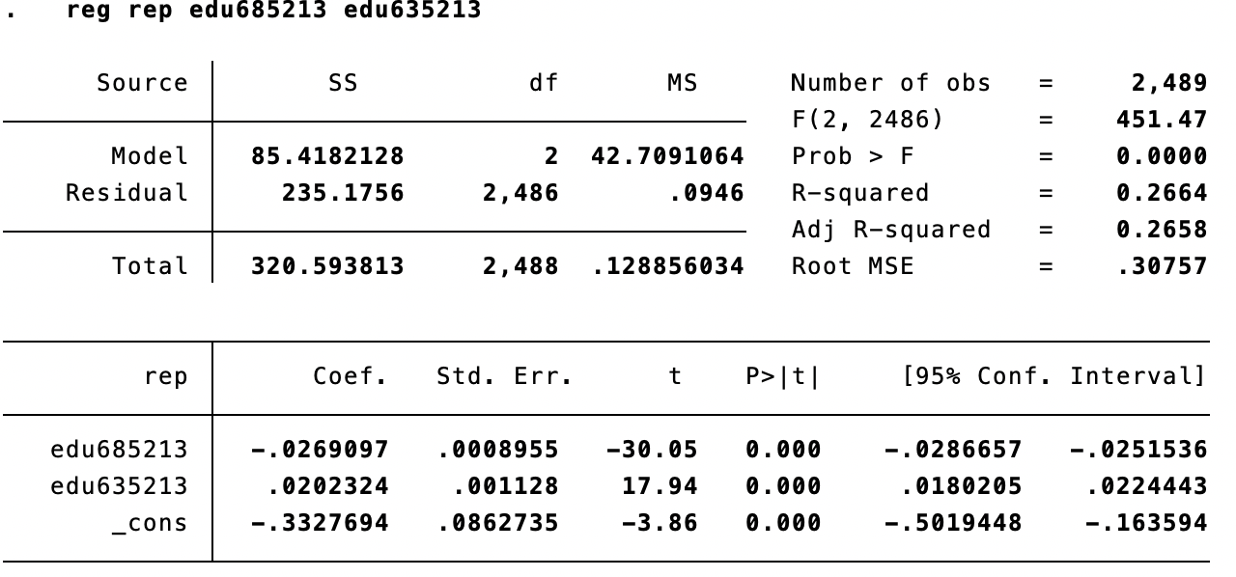
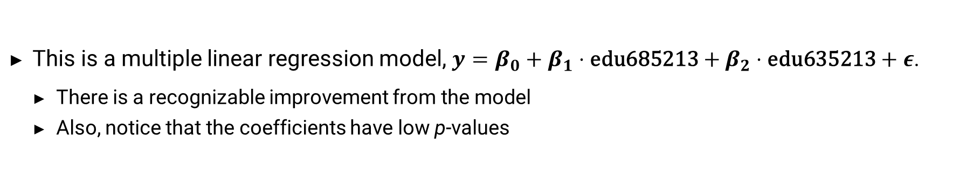
Regression – Multiple Regression
1
8
9
10
11
12
13
14
15
16
17
18
19
20
21
22
23
24
25
26
2
3
4
5
6
7
This is a multiple linear regression model, $y=β_{0}+β_{1}⋅\text{edu}\text{685213}+β_{2}⋅\text{edu}\text{635213}+ε$.
There is a recognizable improvement from the model
Also, notice that the coefficients have low p-values

Slide 26
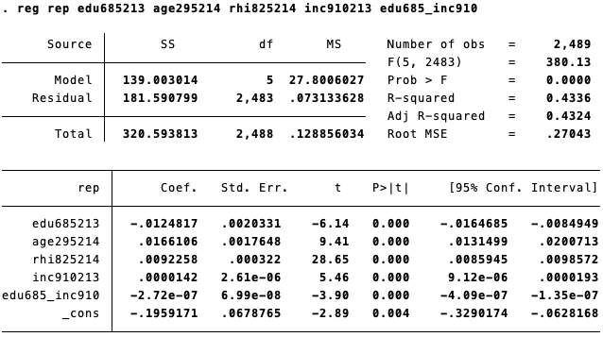
Regression – Multiple Regression
1
8
9
10
11
12
13
14
15
16
17
18
19
20
21
22
23
24
25
26
2
3
4
5
6
7
Our final model exhibits relatively high performance with coefficients statistically significant
Adjusted R-Squared: 0.4324
Each coefficient represents a percentage point difference on selecting Trump by a unit change in the variable (e.g., having 1% higher proportion of Persons under 18 years lead to 1.66 p.p increase in chances of selecting Trump)
BONUS: Instead of Linear Regression model, what can we use to address this classification problem?

Slide 27
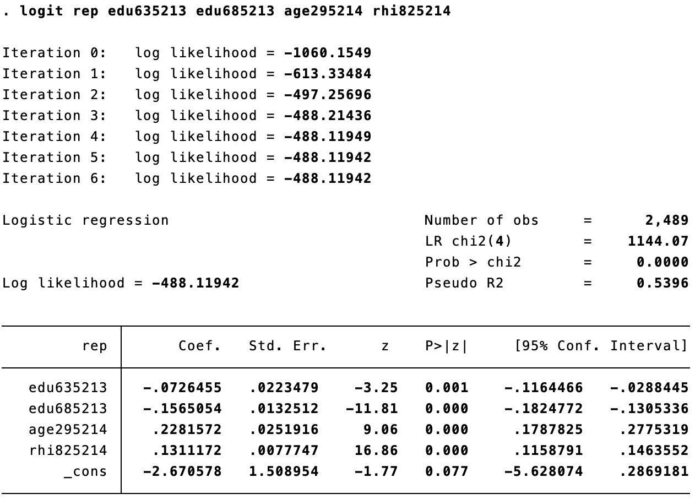
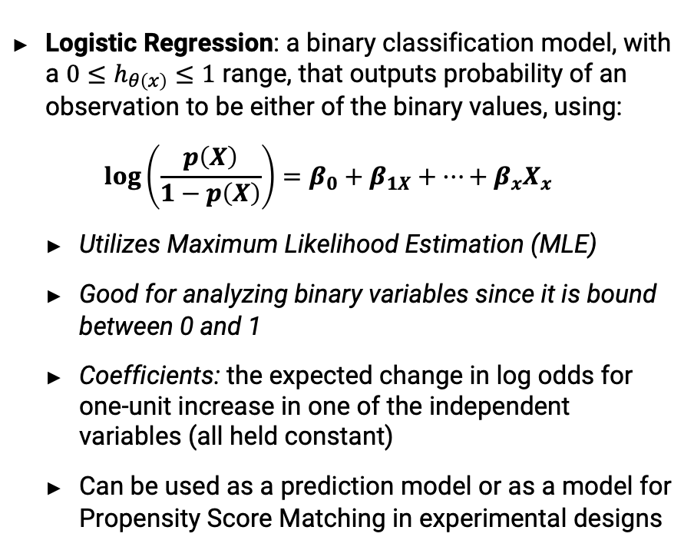
Regression – Logistic Regression
1
8
9
10
11
12
13
14
15
16
17
18
19
20
21
22
23
24
25
26
2
3
4
5
6
7
Logistic Regression: a binary classification model, with a $0≤h_{θ\left(x\right)}≤1$ range, that outputs probability of an observation to be either of the binary values, using: $\log\left(\frac{p\left(X\right)}{1−p\left(X\right)}\right)=β_{0}+β_{1X}+⋯+β_{x}X_{x}$
Utilizes Maximum Likelihood Estimation (MLE)
Good for analyzing binary variables since it is bound between 0 and 1
Coefficients: the expected change in log odds for one-unit increase in one of the independent variables (all held constant)
Can be used as a prediction model or as a model for Propensity Score Matching in experimental designs

Slide 28
Charts – Syntax and Examples
1
8
9
10
11
12
13
14
15
16
17
18
19
20
21
22
23
24
25
26
2
3
4
5
6
7
Histogram of INC910213
Regression Plot of Simple Linear Regression
Command: hist inc910213
twoway scatter yhat_ex sbo001207 pst045214, connect(l .) symbol(i 0)

Slide 29
Charts – Syntax and Examples
1
8
9
10
11
12
13
14
15
16
17
18
19
20
21
22
23
24
25
26
2
3
4
5
6
7
Simple Linear Regression Plot
Regression Plot of Simple Logistic Regression (Logit)
twoway scatter yhat_linear rep edu685213, connect(l .) symbol(i 0) sort ylabel(0 1)
twoway scatter yhat_logit rep edu685213, connect(l i) msymbol(i 0) sort ylabel(0 1)

Slide 30
Charts – Syntax and Examples
1
8
9
10
11
12
13
14
15
16
17
18
19
20
21
22
23
24
25
26
2
3
4
5
6
7
Simple Linear vs. Multiple
Linear Regression Plot
Regression Plot of Multiple Logistic Regression (Logit)
twoway scatter rep MLR yhat_linear edu685213, connect(. l -) msymbol(. i i) sort ylabel(0 1)
twoway scatter yhat_all rep edu685213, connect(l i) msymbol(i 0) sort ylabel(0 1)

Slide 31
Hands-on Exercise
1
8
9
10
11
12
13
14
15
16
17
18
19
20
21
22
23
24
25
26
2
3
4
5
6
7
Using the sqf-2019.xlsx (NYCLU’s 2019 NYC Stop-and-Frisk Dataset), generate the following output:
Plot the distribution of age variable with a normal distribution, with 25 bins (bars). How does the distribution look like compared to the normal distribution?
Run summary statistics for age, weight and height variables. What can you imply about the variables?
Graph a bar chart to plot mean age across 5 borrows of New York City. Note that a default value for a bar chart is mean.
Use Logistic Regression to show how a probability of suspects found with a weapon is influenced by age, weight, height, and a dummy variable for Manhattan borough.

Slide 32
Summary / Q&A
Key Takeaways:
User Interface (Do-File)
Data Import and Exploration
Summary Statistics
Regression Analysis
Tips:
Stata/R Useful Packages: https://geocenter.github.io/StataTraining/portfolio/06_resource/
Internet Guide to Stata: http://wlm.userweb.mwn.de/Stata/
UCLA IDRE Guide: https://stats.idre.ucla.edu/stata/
Princeton DSS: https://www.princeton.edu/~otorres/Stata/StataTutorial.pdf
Contact: theqcl@cmc.edu (with a title: “Re: QCL Stata Workshop”)
Feel free to contact me (slee19@students.cmc.edu) if you have any questions on PowerPoint and Stata materials

Slide 33
Appendix

Slide 34
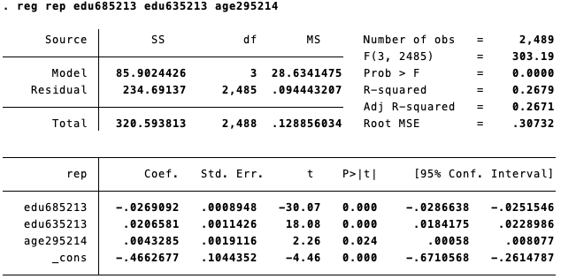
Regression – Multiple Regression
1
8
9
10
11
12
13
14
15
16
17
18
19
20
21
22
23
24
25
26
2
3
4
5
6
7
Let’s try to add more explanatory variable: age295214 (persons under 18 years)
We can see from Adjusted R² that there is a lot of room to improve (73.29% of variation is still not explained)
Also, note that age295214 has a relatively high p-value but within 95% Confidence Level
Can adding rhi825214 (White alone, Not Hispanic) help to increase our model’s performance?

Slide 35
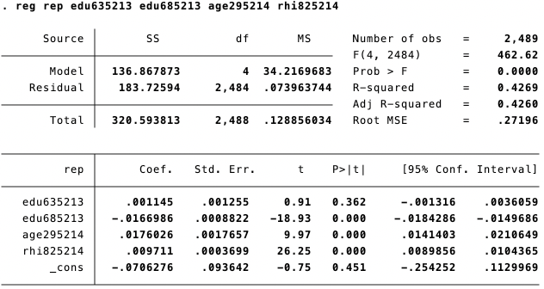
Regression – Multiple Regression
1
8
9
10
11
12
13
14
15
16
17
18
19
20
21
22
23
24
25
26
2
3
4
5
6
7
As expected, including race variable leads to better performance (42.69% of variation explained)
We also see that a coefficient of the high school graduates is not statistically significant. Why?
How should we proceed?
Notes:
Instead add rhi825214 so that reg rep edu635213 edu685213 age295214 rhi825214

Slide 36
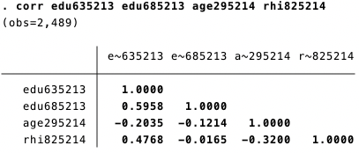
Regression – Multiple Regression
1
8
9
10
11
12
13
14
15
16
17
18
19
20
21
22
23
24
25
26
2
3
4
5
6
7
Is edu635213 variable duplicitous in our model? Should we exclude them?
What other variables do you think we can include in our model? (Hint: Think about how policies impact people based on their background)
Notes:
reg rep edu635213 edu685213 age295214 rhi825214 → should we include income information?
What kind of things can we expect, given our explanatory variables? (edu685213 could be correlated with income); better education more income

Slide 37
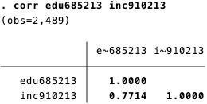
Regression – Multiple Regression
1
8
9
10
11
12
13
14
15
16
17
18
19
20
21
22
23
24
25
26
2
3
4
5
6
7
How about Income variable?
INC910213: Per Capita Income
From checking the correlation table, what can we infer about the relationship between the level of education and per capital income level?
If we assume that the impact of income on political leanings differ by the education level, we can use two methods: 1) Interaction Terms 2) Instrumental Variable (IV)

Slide 38
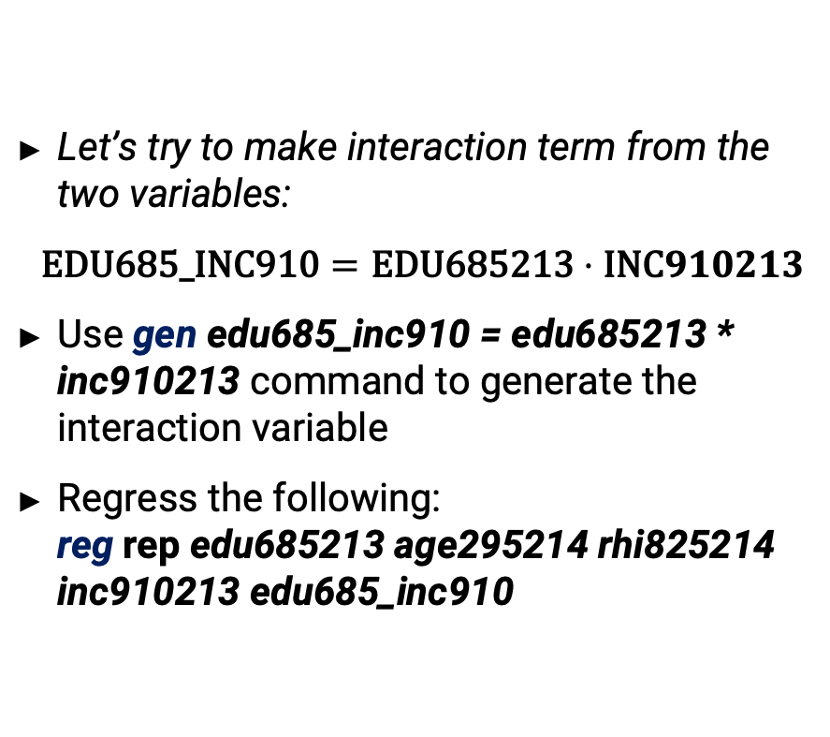
Regression – Multiple Regression
1
8
9
10
11
12
13
14
15
16
17
18
19
20
21
22
23
24
25
26
2
3
4
5
6
7
Let’s try to make interaction term from the two variables:
$$\text{EDU}\text{685_}\text{INC}\text{910}=\text{EDU}\text{685213}⋅\text{INC}910213$$
Use gen edu685_inc910 = edu685213 * inc910213 command to generate the interaction variable
Regress the following: reg rep edu685213 age295214 rhi825214 inc910213 edu685_inc910

